Slide 1
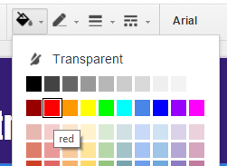
Instructions
Want access to this file? Please don’t click the “Share” button. Instead, click “File > Make a copy …” to copy it into your Google Drive. Thanks!
To set up the game, write your questions into the question text boxes and your answers into the answer text boxes. For each question, be sure to have a slide with just the question/answers and a slide with the correct answer highlighted.
For each question, you can write your questions and answers on the slides provided. Or, if that seems like too much work, you can duplicate the question slide (right-click the slide on the left of the screen and choose “duplicate slide”) and change the correct answer to red.
All answer slides have “A” marked as the correct answer, but that can easily be changed. To change the color of an answer box, click it and click the paint bucket icon in the tool bar above. Boxes for correct answers are red; all other answer boxes are black.
Once the game begins, just advance through the slides with the space bar or arrow keys to play the game. Clicking on the chosen answer won’t do anything differently.

Slide 2
CLICK HERE TO BEGIN

Slide 3
$1,000,000
$500,000
$250,000
$125,000
$64,000
$32,000
$16,000
$8,000
Question text
goes here
$4,000
$2,000
$1,000
$500
A. Answer text here
C. Answer text here
$400
$300
B. Answer text here
D. Answer text here
$200
$100

Slide 4
$1,000,000
$500,000
$250,000
$125,000
$64,000
$32,000
$16,000
$8,000
Question text
goes here
$4,000
$2,000
$1,000
$500
A. Answer text here
C. Answer text here
$400
$300
B. Answer text here
D. Answer text here
$200
$100

Slide 5
$1,000,000
$500,000
$250,000
$125,000
$64,000
$32,000
$16,000
$8,000
Question text
goes here
$4,000
$2,000
$1,000
$500
A. Answer text here
C. Answer text here
$400
$300
B. Answer text here
D. Answer text here
$200
$100

Slide 6
$1,000,000
$500,000
$250,000
$125,000
$64,000
$32,000
$16,000
$8,000
Question text
goes here
$4,000
$2,000
$1,000
$500
A. Answer text here
C. Answer text here
$400
$300
B. Answer text here
D. Answer text here
$200
$100

Slide 7
$1,000,000
$500,000
$250,000
$125,000
$64,000
$32,000
$16,000
$8,000
Question text
goes here
$4,000
$2,000
$1,000
$500
A. Answer text here
C. Answer text here
$400
$300
B. Answer text here
D. Answer text here
$200
$100

Slide 8
$1,000,000
$500,000
$250,000
$125,000
$64,000
$32,000
$16,000
$8,000
Question text
goes here
$4,000
$2,000
$1,000
$500
A. Answer text here
C. Answer text here
$400
$300
B. Answer text here
D. Answer text here
$200
$100

Slide 9
$1,000,000
$500,000
$250,000
$125,000
$64,000
$32,000
$16,000
$8,000
Question text
goes here
$4,000
$2,000
$1,000
$500
A. Answer text here
C. Answer text here
$400
$300
B. Answer text here
D. Answer text here
$200
$100

Slide 10
$1,000,000
$500,000
$250,000
$125,000
$64,000
$32,000
$16,000
$8,000
Question text
goes here
$4,000
$2,000
$1,000
$500
A. Answer text here
C. Answer text here
$400
$300
B. Answer text here
D. Answer text here
$200
$100

Slide 11
$1,000,000
$500,000
$250,000
$125,000
$64,000
$32,000
$16,000
$8,000
Question text
goes here
$4,000
$2,000
$1,000
$500
A. Answer text here
C. Answer text here
$400
$300
B. Answer text here
D. Answer text here
$200
$100

Slide 12
$1,000,000
$500,000
$250,000
$125,000
$64,000
$32,000
$16,000
$8,000
Question text
goes here
$4,000
$2,000
$1,000
$500
A. Answer text here
C. Answer text here
$400
$300
B. Answer text here
D. Answer text here
$200
$100

Slide 13
$1,000,000
$500,000
$250,000
$125,000
$64,000
$32,000
$16,000
$8,000
Question text
goes here
$4,000
$2,000
$1,000
$500
A. Answer text here
C. Answer text here
$400
$300
B. Answer text here
D. Answer text here
$200
$100

Slide 14
$1,000,000
$500,000
$250,000
$125,000
$64,000
$32,000
$16,000
$8,000
Question text
goes here
$4,000
$2,000
$1,000
$500
A. Answer text here
C. Answer text here
$400
$300
B. Answer text here
D. Answer text here
$200
$100

Slide 15
$1,000,000
$500,000
$250,000
$125,000
$64,000
$32,000
$16,000
$8,000
Question text
goes here
$4,000
$2,000
$1,000
$500
A. Answer text here
C. Answer text here
$400
$300
B. Answer text here
D. Answer text here
$200
$100

Slide 16
$1,000,000
$500,000
$250,000
$125,000
$64,000
$32,000
$16,000
$8,000
Question text
goes here
$4,000
$2,000
$1,000
$500
A. Answer text here
C. Answer text here
$400
$300
B. Answer text here
D. Answer text here
$200
$100

Slide 17
$1,000,000
$500,000
$250,000
$125,000
$64,000
$32,000
$16,000
$8,000
Question text
goes here
$4,000
$2,000
$1,000
$500
A. Answer text here
C. Answer text here
$400
$300
B. Answer text here
D. Answer text here
$200
$100

Slide 18
$1,000,000
$500,000
$250,000
$125,000
$64,000
$32,000
$16,000
$8,000
Question text
goes here
$4,000
$2,000
$1,000
$500
A. Answer text here
C. Answer text here
$400
$300
B. Answer text here
D. Answer text here
$200
$100

Slide 19
$1,000,000
$500,000
$250,000
$125,000
$64,000
$32,000
$16,000
$8,000
Question text
goes here
$4,000
$2,000
$1,000
$500
A. Answer text here
C. Answer text here
$400
$300
B. Answer text here
D. Answer text here
$200
$100

Slide 20
$1,000,000
$500,000
$250,000
$125,000
$64,000
$32,000
$16,000
$8,000
Question text
goes here
$4,000
$2,000
$1,000
$500
A. Answer text here
C. Answer text here
$400
$300
B. Answer text here
D. Answer text here
$200
$100

Slide 21
$1,000,000
$500,000
$250,000
$125,000
$64,000
$32,000
$16,000
$8,000
Question text
goes here
$4,000
$2,000
$1,000
$500
A. Answer text here
C. Answer text here
$400
$300
B. Answer text here
D. Answer text here
$200
$100

Slide 22
$1,000,000
$500,000
$250,000
$125,000
$64,000
$32,000
$16,000
$8,000
Question text
goes here
$4,000
$2,000
$1,000
$500
A. Answer text here
C. Answer text here
$400
$300
B. Answer text here
D. Answer text here
$200
$100

Slide 23
$1,000,000
$500,000
$250,000
$125,000
$64,000
$32,000
$16,000
$8,000
Question text
goes here
$4,000
$2,000
$1,000
$500
A. Answer text here
C. Answer text here
$400
$300
B. Answer text here
D. Answer text here
$200
$100

Slide 24
$1,000,000
$500,000
$250,000
$125,000
$64,000
$32,000
$16,000
$8,000
Question text
goes here
$4,000
$2,000
$1,000
$500
A. Answer text here
C. Answer text here
$400
$300
B. Answer text here
D. Answer text here
$200
$100

Slide 25
$1,000,000
$500,000
$250,000
$125,000
$64,000
$32,000
$16,000
$8,000
Question text
goes here
$4,000
$2,000
$1,000
$500
A. Answer text here
C. Answer text here
$400
$300
B. Answer text here
D. Answer text here
$200
$100

Slide 26
$1,000,000
$500,000
$250,000
$125,000
$64,000
$32,000
$16,000
$8,000
Question text
goes here
$4,000
$2,000
$1,000
$500
A. Answer text here
C. Answer text here
$400
$300
B. Answer text here
D. Answer text here
$200
$100

Slide 27
$1,000,000
$500,000
$250,000
$125,000
$64,000
$32,000
$16,000
$8,000
Question text
goes here
$4,000
$2,000
$1,000
$500
A. Answer text here
C. Answer text here
$400
$300
B. Answer text here
D. Answer text here
$200
$100

Slide 28
$1,000,000
$500,000
$250,000
$125,000
$64,000
$32,000
$16,000
$8,000
Question text
goes here
$4,000
$2,000
$1,000
$500
A. Answer text here
C. Answer text here
$400
$300
B. Answer text here
D. Answer text here
$200
$100

Slide 29
$1,000,000
$500,000
$250,000
$125,000
$64,000
$32,000
$16,000
$8,000
Question text
goes here
$4,000
$2,000
$1,000
$500
A. Answer text here
C. Answer text here
$400
$300
B. Answer text here
D. Answer text here
$200
$100

Slide 30
$1,000,000
$500,000
$250,000
$125,000
$64,000
$32,000
$16,000
$8,000
Question text
goes here
$4,000
$2,000
$1,000
$500
A. Answer text here
C. Answer text here
$400
$300
B. Answer text here
D. Answer text here
$200
$100

Slide 31
$1,000,000
$500,000
$250,000
$125,000
$64,000
$32,000
$16,000
$8,000
Question text
goes here
$4,000
$2,000
$1,000
$500
A. Answer text here
C. Answer text here
$400
$300
B. Answer text here
D. Answer text here
$200
$100

Slide 32
$1,000,000
$500,000
$250,000
$125,000
$64,000
$32,000
$16,000
$8,000
Question text
goes here
$4,000
$2,000
$1,000
$500
A. Answer text here
C. Answer text here
$400
$300
B. Answer text here
D. Answer text here
$200
$100

Slide 33
$1,000,000
$500,000
$250,000
$125,000
$64,000
$32,000
$16,000
$8,000
Question text
goes here
$4,000
$2,000
$1,000
$500
A. Answer text here
C. Answer text here
$400
$300
B. Answer text here
D. Answer text here
$200
$100

Slide 34
$1,000,000
$500,000
$250,000
$125,000
$64,000
$32,000
$16,000
$8,000
Question text
goes here
$4,000
$2,000
$1,000
$500
A. Answer text here
C. Answer text here
$400
$300
B. Answer text here
D. Answer text here
$200
$100

Slide 35
$1,000,000
$500,000
$250,000
$125,000
$64,000
$32,000
$16,000
$8,000
Question text
goes here
$4,000
$2,000
$1,000
$500
A. Answer text here
C. Answer text here
$400
$300
B. Answer text here
D. Answer text here
$200
$100

Slide 36
$1,000,000
$500,000
$250,000
$125,000
$64,000
$32,000
$16,000
$8,000
Question text
goes here
$4,000
$2,000
$1,000
$500
A. Answer text here
C. Answer text here
$400
$300
B. Answer text here
D. Answer text here
$200
$100

Slide 37
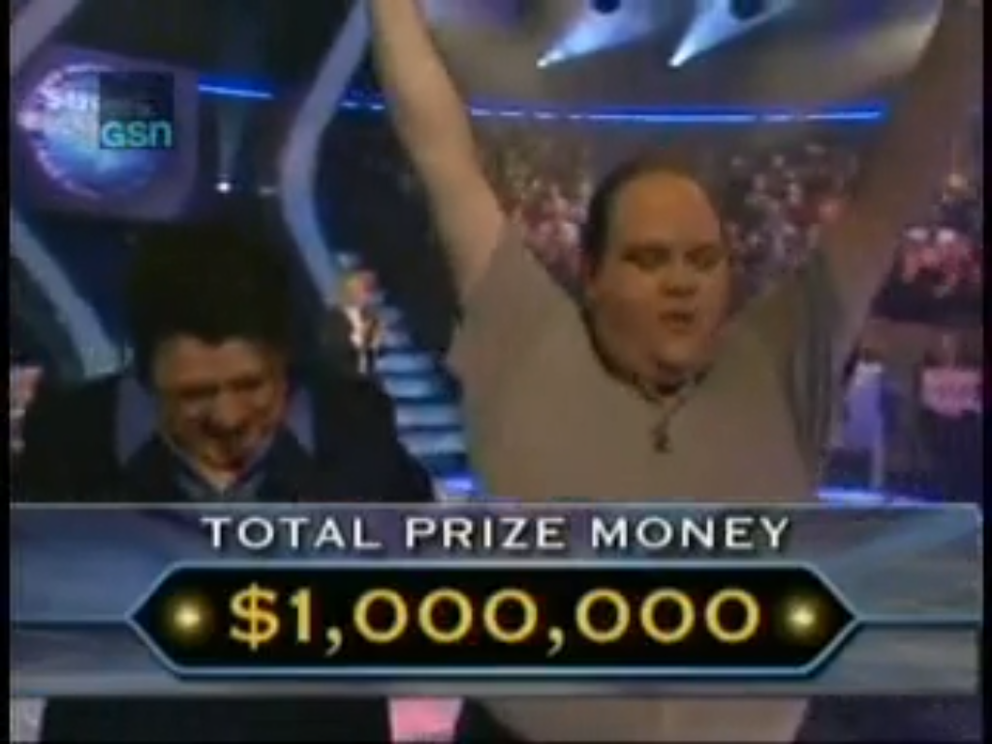
CONGRATULATIONS! YOU WIN!

