Slide 1
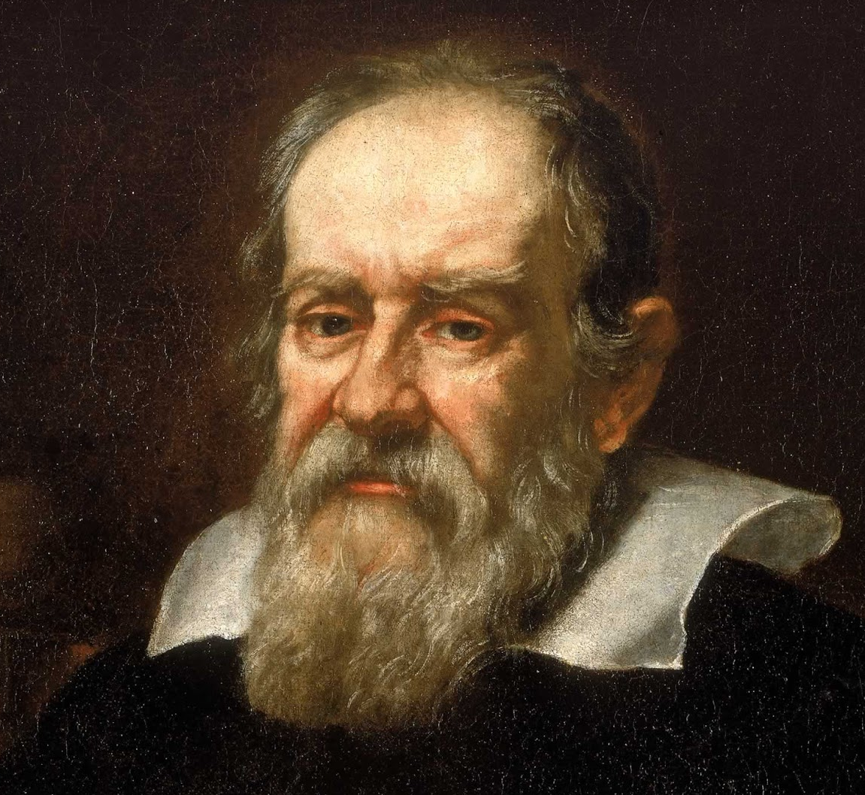
If the title of this file (top left) says “Copy of”, then this file is yours in your own Google Drive. Delete this text box and get to work! :)
If it doesn’t say “Copy of,” you’re looking at my file. Make a copy of this file by going to File > Make a copy.
PLEASE do not request edit access to this file. I won’t give it (so you don’t change this file that others may want to access). This is the original. Make a copy of it! #FileMakeACopy
Instructions for using this file:
1. Use the “+” button in the top left to make a copy of this slide for every student in your class.
2. Share this slide presentation with your students. Make it “Anyone with the link can edit.”
3. Have each student make a tweet on his/her own slide! Put a photo over the CNN logo. Add name in dark bold and Twitter username in gray. Then type the tweet!
Galileo Galilei
@TheREALGalileo
Solar eclipses never get old. #SolarEclipse2017

