Slide 1
Notes:
Easy no editing. Use send to back on video. In white

Slide 2
Notes:
Easy no editing. Use send to back on video. In white

Slide 3
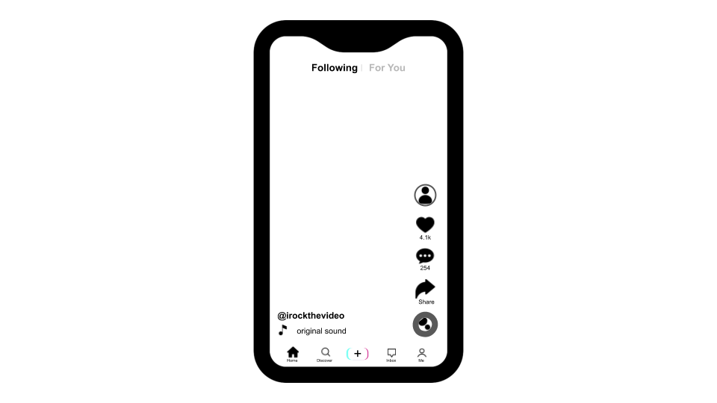
Simple version
(Black icons)
Notes:
Easy no editing. Use send to back on video. In black

Slide 4
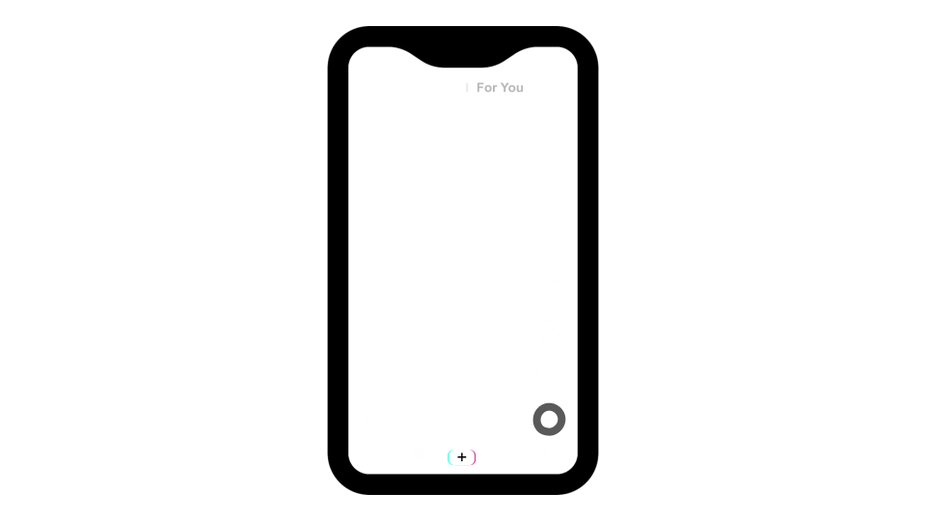
Simple version
(White icons)
Notes:
Easy no editing. Use send to back on video. In white

Slide 5
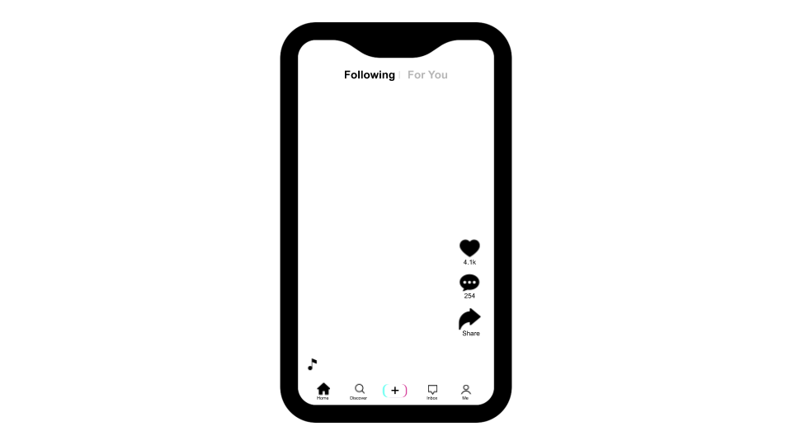
Customizable version
(Black icons)
@irockthevideo
original sound
Notes:
Edit text + user. Send video to back. In black.

Slide 6
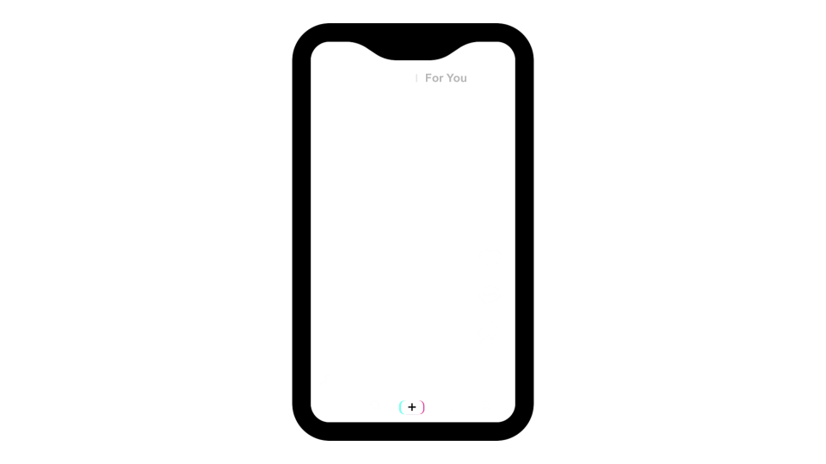
Customizable version
(White icons)
@irockthevideo
original sound
Notes:
Edit text + user. Send video to back. In white.

Slide 7
The original
(with all the icons and text boxes)
(White icons)
Following ⃒ For You
4.1k
254
Share
@irockthevideo
original sound
+
Home
Discover
Inbox
Me
Notes:
Original

