Slide 1
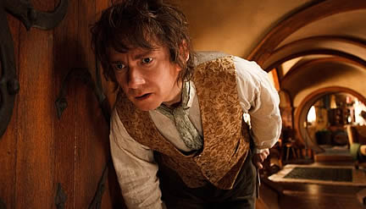
What is Bilbo likely thinking in this moment? Write/type his thoughts in the thought bubble text box and turn in to Google Classroom.

