Slide 1
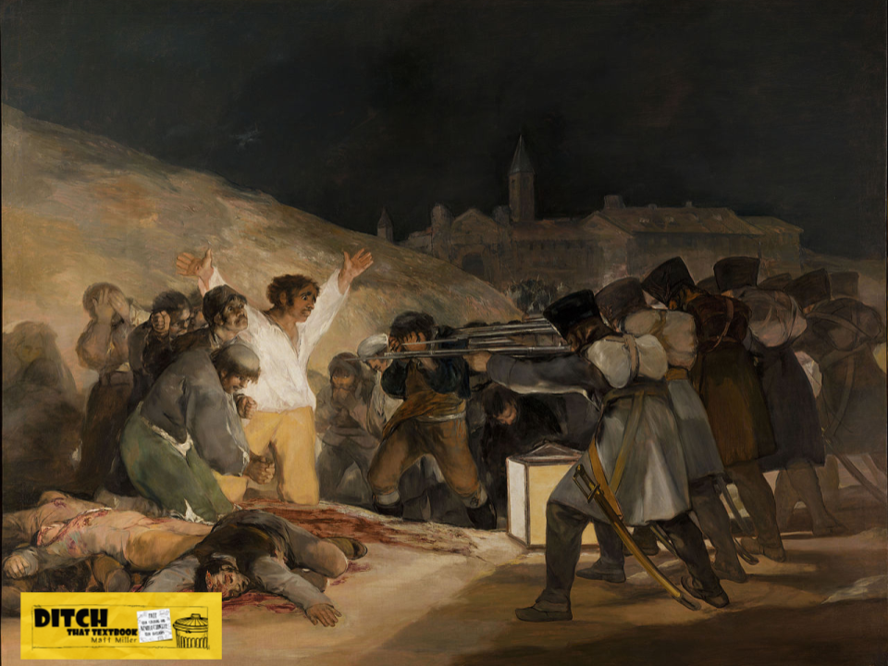
Depicts executions after Napoleon invaded Spain in 1808.
El Tres de Mayo
A painting by Francisco Goya (1814)
Main figure is a simple laborer.
A repoussoir: direct viewer’s eye to main focal point
Firing squad’s faces can’t be seen, impersonalizing them.
A square lantern lights the scene.

