Slide 1
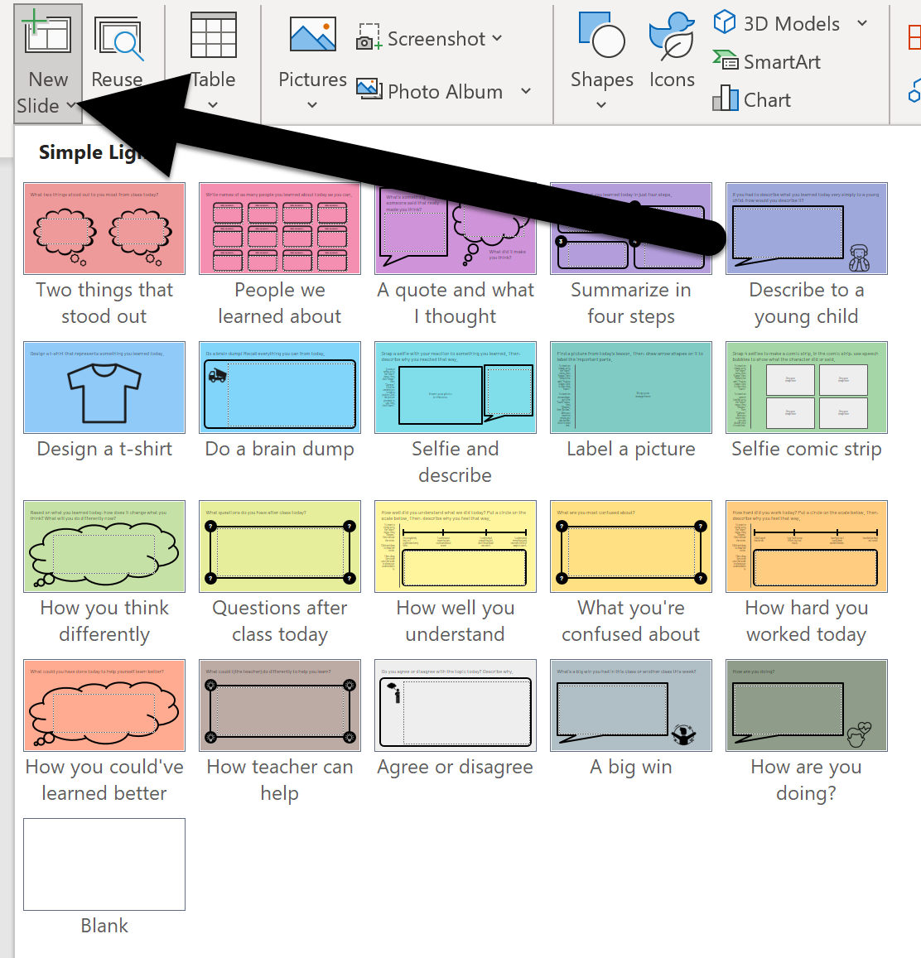
How to use the exit ticket builder:
Open this exit ticket builder in PowerPoint.
Add exit tickets by clicking the down arrow on the New Slide button. Then click an exit ticket to add it to this slide deck.
Before you add slides, you can modify any of them in the master slide by clicking the “View” menu and “Slide Master.” You can adjust the wording of text or add new things there.
When you’ve added your exit tickets, save the file with a name to reflect the day you’re assigning it (i.e. “April 20 exit ticket”) and delete this instructions slide.
Assign it to your students with Microsoft Teams or your learning management system (LMS) like Canvas, Schoology, Blackboard, Google Classroom, etc.

