Slide 1

MY NOTEBOOK
TITLE
Name
Class
Period

Slide 2
Labeling an image
Use this arrow to label.
Use this arrow to label.
Use this arrow to label.
Use this arrow to label.
Insert an image on this slide. Then drag arrows on the image to identify parts and the text box built into the arrows to label. But that’s just the beginning! Add any other elements to annotate this image, too!
Use this arrow to label.
Use this arrow to label.
Use this arrow to label.
Use this arrow to label.
Use this arrow to label.
Use this arrow to label.

Slide 3
Caption This!
Insert an image on this slide. Then use the speech/thought bubbles to show what people in the image are thinking/saying. But that’s just the beginning! Add any other elements to annotate this image, too! (PS: Click on a speech/thought bubble and drag the yellow dot to move the tail of the bubble around!)

Slide 4

Moveable vocabulary
Vocab word
Vocab word
Category 1 for sorting
Category 2 for sorting
Vocab word
Vocab word
Vocab word
Vocab word
Vocab word
Vocab word
Vocab word
Vocab word
Category 3 for sorting
Category 4 for sorting
Vocab word
Vocab word
Vocab word
Vocab word
Vocab word
Vocab word

Slide 5












Digital diorama/map
Use icons (at left), shapes, lines, text, images, etc. to recreate a map -- or create a digital “diorama” of a scene. Add lots of details to show what you’ve learned about the scene and what happened there. (Also, leave the attribution line at the bottom of the scene if you use the icons. Citing the artist that created the icons is what we do to give credit to who created them.)
Icons by Gregor Cresnar via TheNounProject.com

Slide 6
Here’s some text you can replace with your own!
Here’s some text you can replace with your own!
Comic strips
Here’s some text you can replace with your own!
Here’s some text you can replace with your own!
Here’s some text you can replace with your own!
Here’s some text you can replace with your own!
Here’s some text you can replace with your own!
Here’s some text you can replace with your own!
Use these frames (or resize them … or add more of your own … whatever!) for panels of a comic strip. Use the webcam (Insert > Image > Camera) to insert pictures taken of you. Add images. Use icons. Use shapes. Build out your comic strip to show what you have learned.

Slide 7
Lab report / Series of pictures
Here is a text box where you can add your description of what’s happening in the image!
1
6
Insert your image here. To take a picture with your webcam, go to Insert > Image > Camera.
2
7
Take pictures of your science lab, process, demonstration, etc. Insert those pictures on slides. Add text boxes with descriptions of what’s happening in each slide. Add the red numbered dots on top of each of your images so we know what order they go in.
3
8
Here is a text box where you can add your description of what’s happening in the image!
4
9
Insert your image here. To take a picture with your webcam, go to Insert > Image > Camera.
5
10

Slide 8
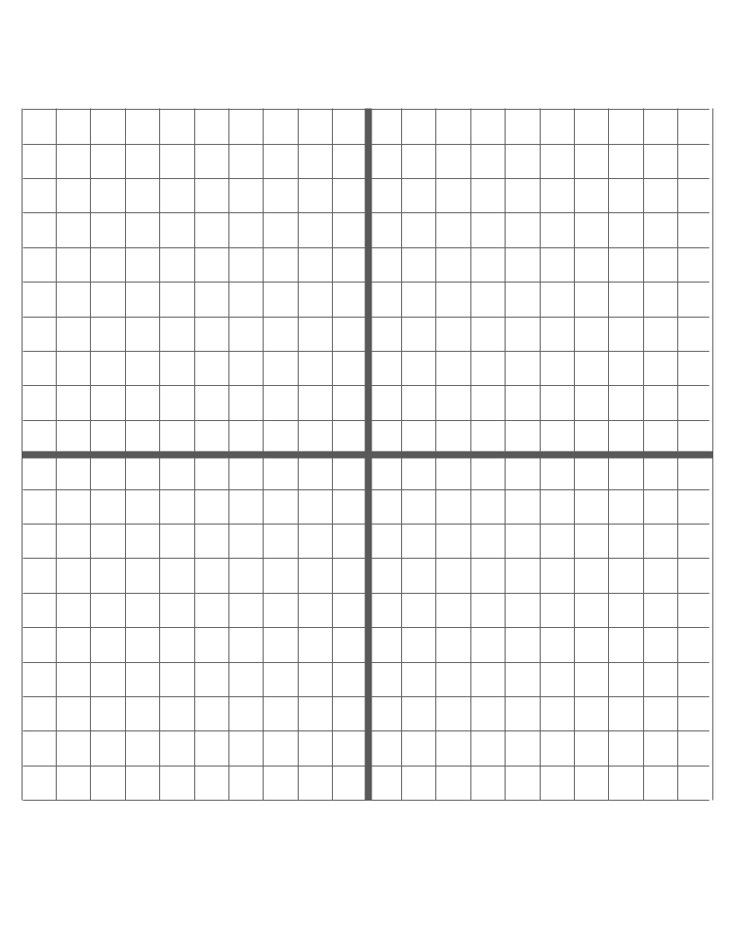
Coordinate plane
Use the dots on the left side of this page to plot on the coordinate plane. Click on a dot and use Ctrl + D to duplicate it. Add lines with the line tool in the toolbar. Use the text box at the bottom to have students describe their work!
Tip: If you click on a dot and the blue resizing squares get in the way, click off the dot and then click and drag.
Here’s a text box where you can describe -- in words -- what’s happening up on that coordinate plane above. Replace with your own words.

Slide 9
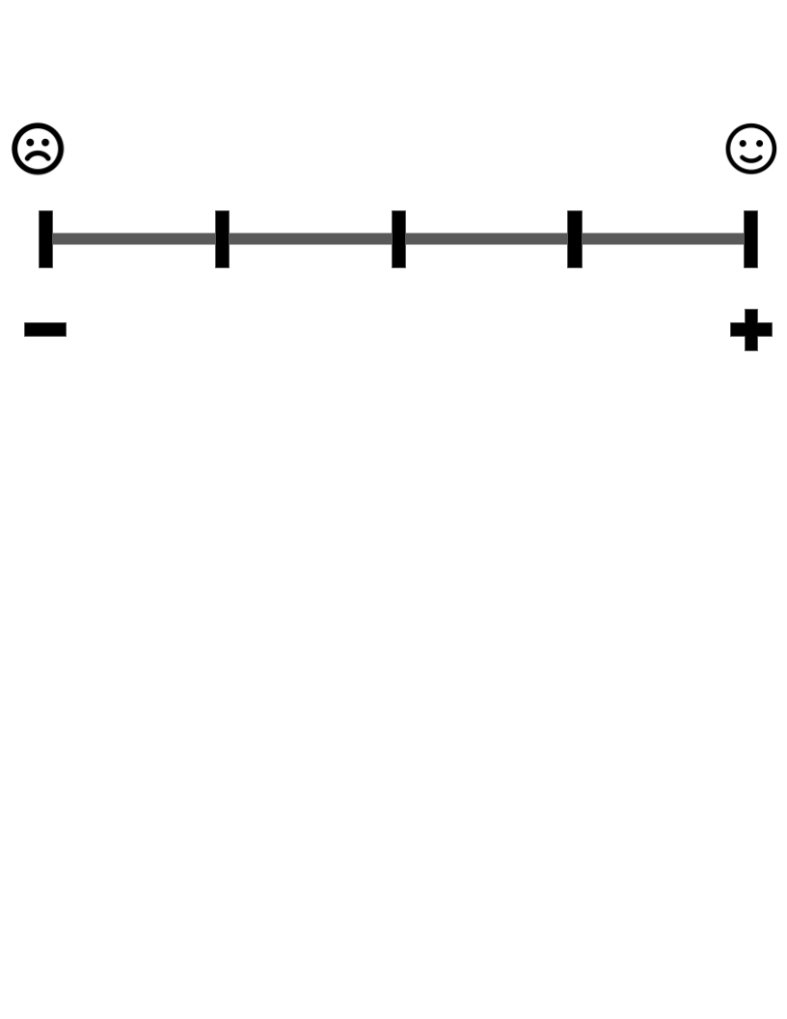
Likert scale
Give students a prompt that they can react to. It could be an opinion question. It could be how a character would react. It could be a value judgment. Drag the green dot on the Likert scale. Then, have students explain their thinking in the text box below.
Here’s a text box where you can describe -- in words -- what’s happening up on that coordinate plane above. Replace with your own words.

Slide 10

Interactive poster
Add images that support your message. Add text to give details. Provide hyperlinks to resources. You can also add arrows, shapes, lines, text, etc. over the top of images. Change the title from “Comic strips” to something that describes your project.
Here is some text. Remove it and replace it with your own! Even add some hyperlinks in it. Here is some text. Remove it and replace it with your own! Even add some hyperlinks in it.
Here is some text. Remove it and replace it with your own! Even add some hyperlinks in it.
Here is some text. Remove it and replace it with your own! Even add some hyperlinks in it.
Here is some text. Remove it and replace it with your own! Even add some hyperlinks in it.
Here is some text. Remove it and replace it with your own! Even add some hyperlinks in it. Here is some text. Remove it and replace it with your own! Even add some hyperlinks in it.
Here is some text. Remove it and replace it with your own! Even add some hyperlinks in it.
Here is some text. Remove it and replace it with your own! Even add some hyperlinks in it.
Here is some text. Remove it and replace it with your own! Even add some hyperlinks in it.
Here is some text. Remove it and replace it with your own! Even add some hyperlinks in it.

Slide 11
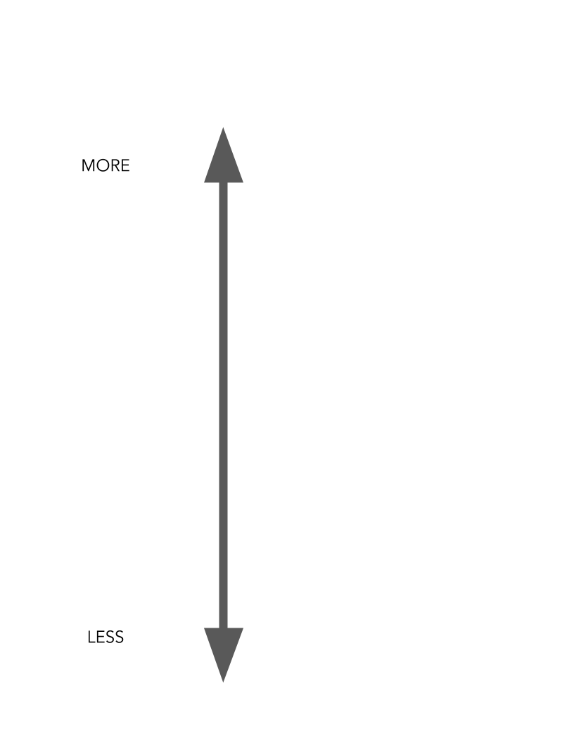
Shades of meaning
Vocab word
Vocab word
Vocab word
Vocab word
Start with a vocabulary word. Then, using a thesaurus, find synonyms and antonyms of that word. Find words that are “more” or “less” than the first vocabulary word that you started with.
Idea from fifth grade teacher Tony Vincent from LearningInHand.com. Click here to see his template.
Vocab word
Vocab word
Vocab word
Vocab word
Vocab word
Vocab word
Vocab word
Vocab word
Vocab word
Vocab word
Vocab word
Vocab word

Slide 12
Sticky note brainstorming
Use the sticky note shapes on the left to get your ideas out and organize them. Click a sticky note and use the Ctrl + D keyboard shortcut to duplicate it. Move it on the page. Double click it to start typing. Use the arrow shapes to show flow or process (if that’s helpful) … Ctrl + D to duplicate them, too.

Slide 13
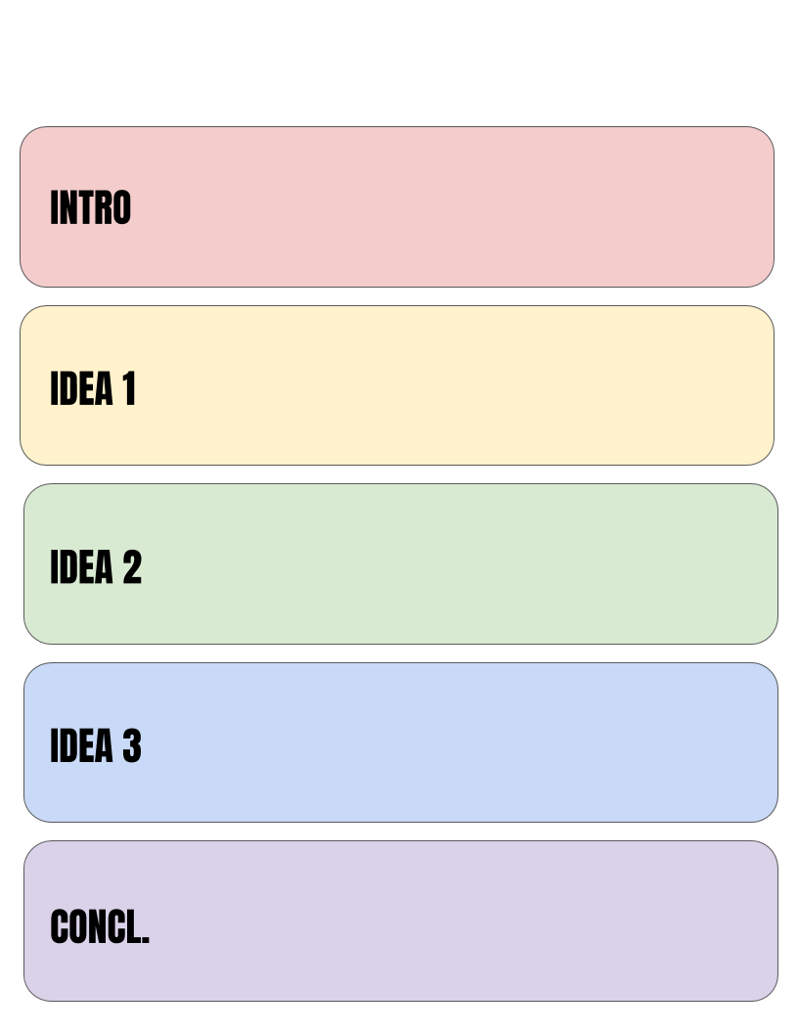
Writer’s notebook: drafting
Your text goes in here.
Decide what you think your three main ideas will be and gather details to support them in their text boxes. Use the introduction to show the reader why it’s important. Use the conclusion to show the reader what he/she just read and what to do going forward. This is just a summary! You’ll go into more detail when you start writing.
Your text goes in here.
Your text goes in here.
Your text goes in here.
Your text goes in here.

Slide 14
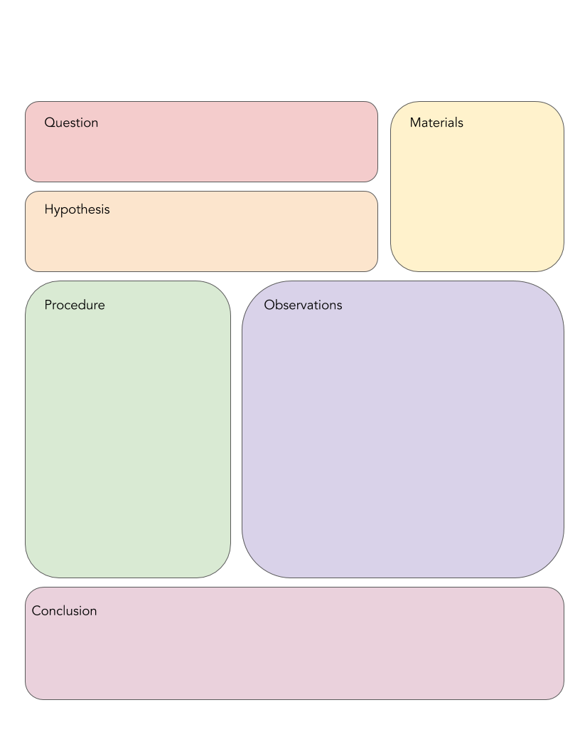
Scientific method
Replace this text with YOUR text!
Replace this text with YOUR text!
Replace this text with YOUR text!
Write out your notes through the various steps of the scientific method in the text boxes provided!
Replace this text with YOUR text!
Replace this text with YOUR text!
Replace this text with YOUR text!

Slide 15
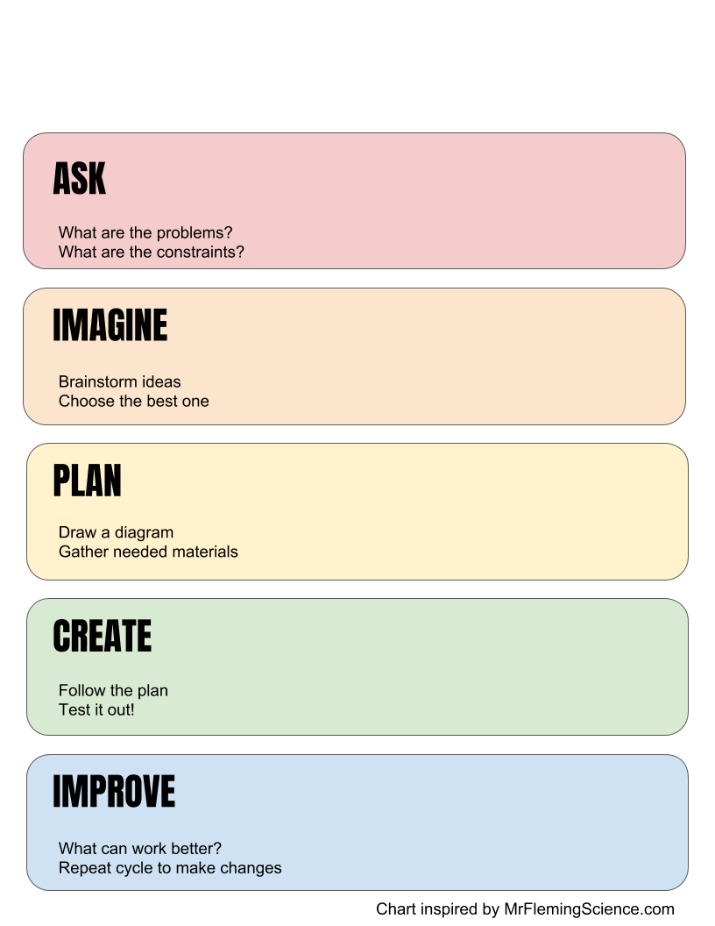
Engineering design process
Replace this with YOUR text!
Work through the design process with the text boxes on this page. OR … create a single page for each step and use shapes, icons, webcam images, text and more to display your thinking!
Replace this with YOUR text!
Replace this with YOUR text!
Replace this with YOUR text!
Replace this with YOUR text!

