Slide 1
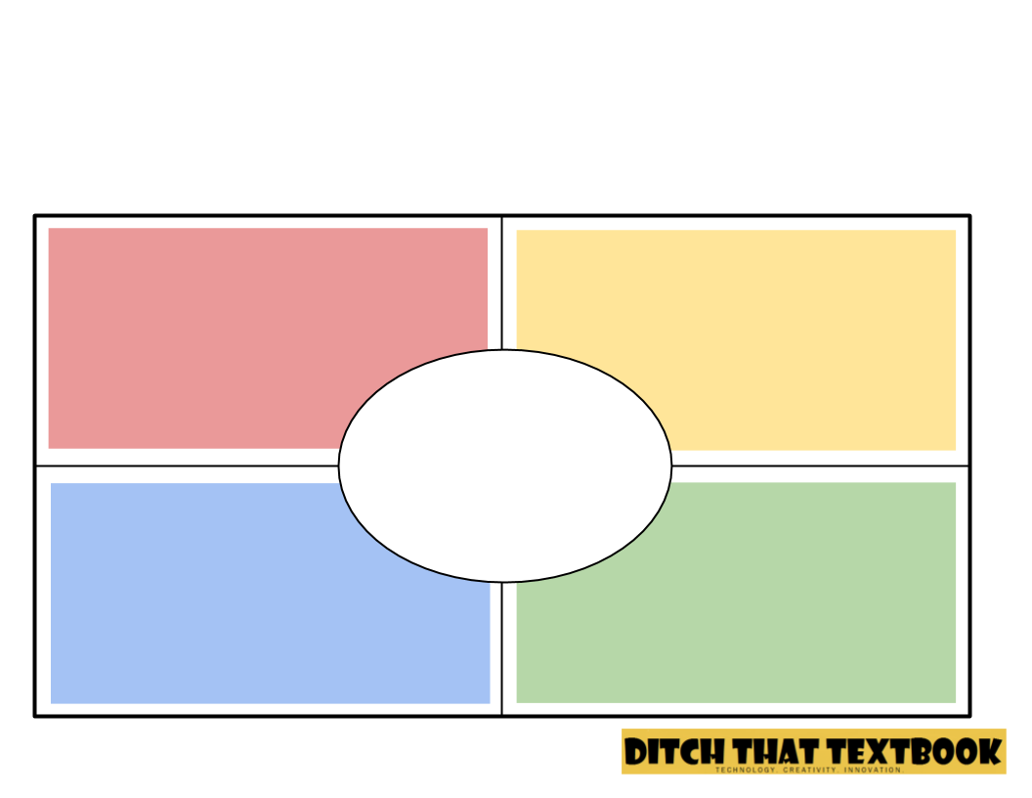
The Frayer Model
Write your instructions in this box. Or, if you don’t want to, you don’t have to … just delete this text box and use the graphic organizer by itself! (Note that there’s no place for student name. If they’re turning it in digitally, there’s likely no need!
Definitions
Characteristics
Text goes here
Text goes here
Examples
Non-Examples
Text goes here
Text goes here

