Slide 1


















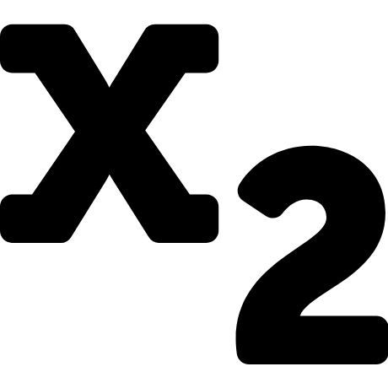















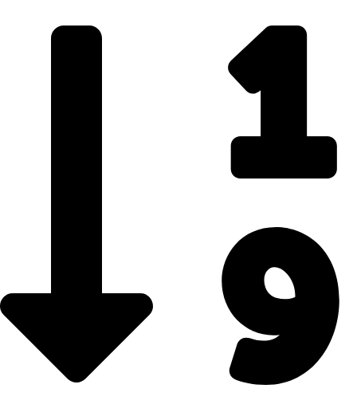




Here’s a text box you can use.
You can use them as frames for organization.
Here’s a speech bubble you can use.
Notes:
Inspiration

