Slide 1



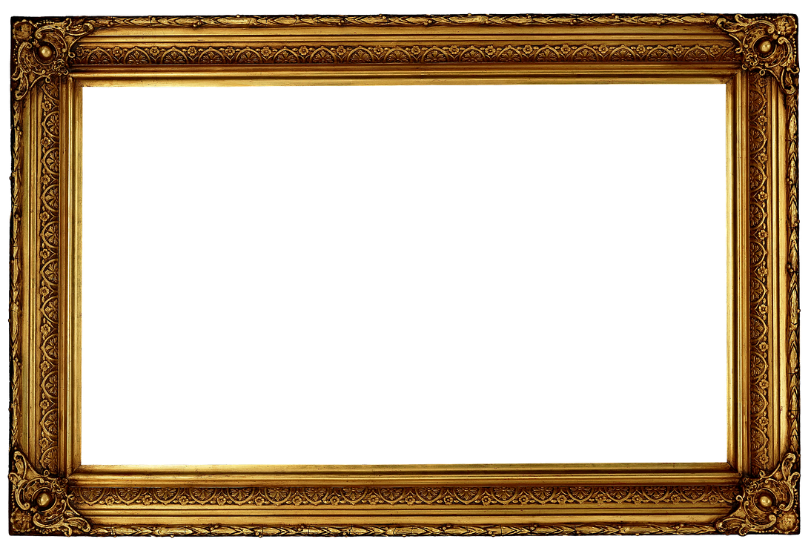











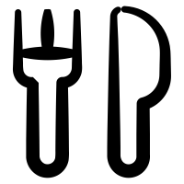

























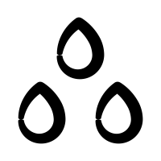
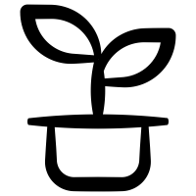








1.
1.
A Gallery of Ideas
Icons by Gregor Cresnar via TheNounProject.com.
More icons: TheNounProject.com

